Slide 1

Differentiable programming for modeling and control of energy systems
Invited talk at the Department of Earth Science and Engineering & Data Science Institute, Imperial College London
Ján Drgoňa Collaborators: Aaron Tuor, James Koch, Stefan Dernbach, Shrirang Abhyankar, Ethan King, Zhao Chen, Soumya Vasisht, Wenceslao Shaw Cortez, Sayak Mukherjee, Mahantesh Halappanavar, Draguna Vrabie

Slide 2

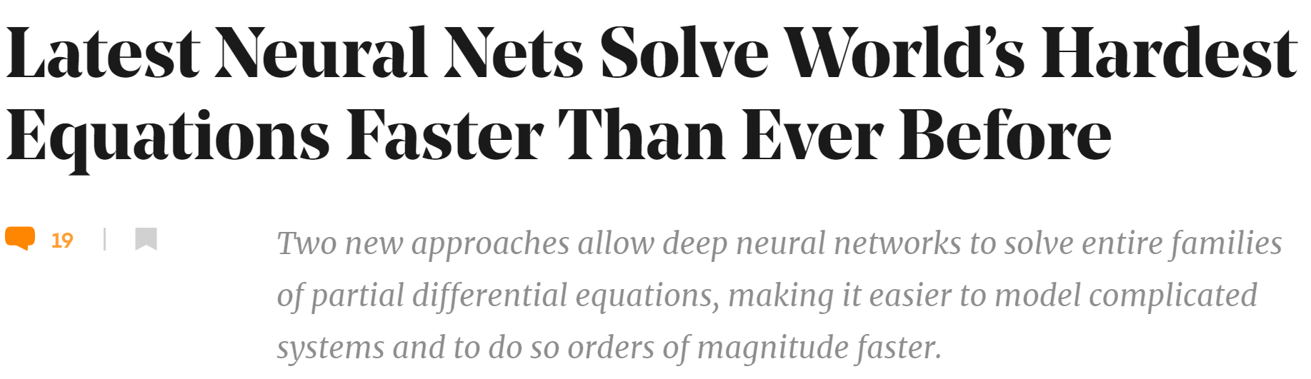

Challenge 1: Systems Modeling
Simulations are crucial for many areas of decision-making and scientific discovery
Need: Improve computational efficiency and scalability for heterogenous scientific simulations
Objectives:
Domain-agnostic software and algorithmic framework
Scientific computing enhanced by data science
Algorithmic speedups enhanced with HPC
Applications: Optimization, modeling and control of dynamical systems (ODE, PDE, DAE, Hybrid systems)

Slide 3
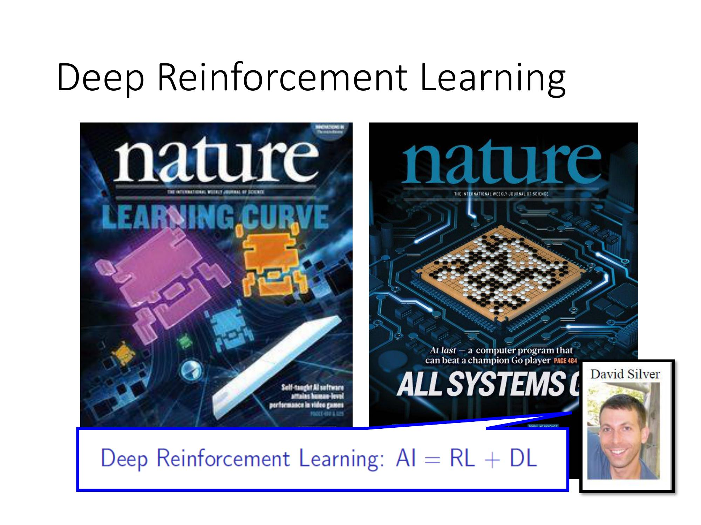

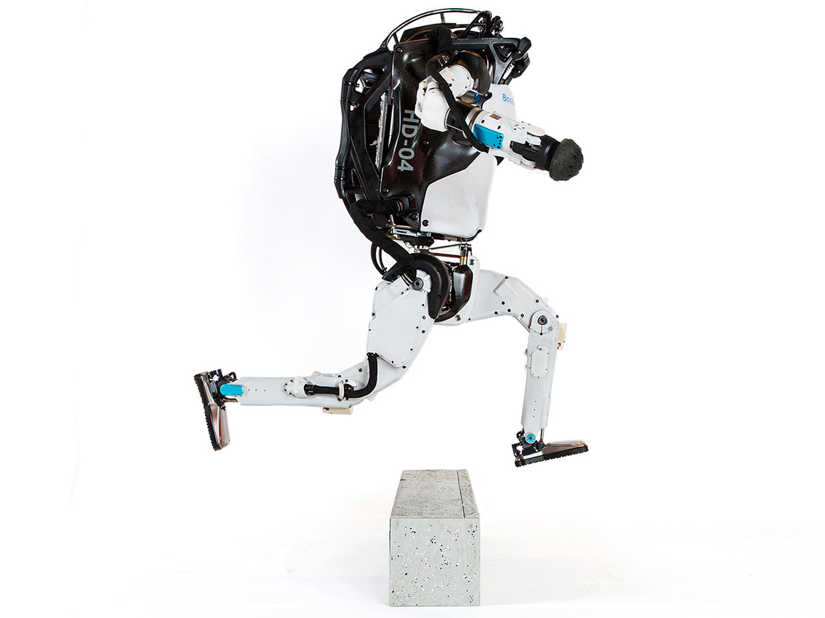
Challenge 2: Systems Control
Model Predictive Control
Reinforcement Learning
95% of the industrial control applications are PID loops & expert driven rule-based control (RBC).
The rest is model predictive control (MPC).
Everywhere where you have reliable digital environment model, mostly discrete action space, and you can use massive compute to solve the problem.
Drgona J., J. Arroyo, I.C. Figueroa, D. Blum, K. Arendt, D. Kim, and E.P. Olle, J. Oravec, M. Wetter, D. L. Vrabie, L. Helsen. 2020. "All You Need to Know About Model Predictive Control for Buildings." Annual Reviews in Control, September 29, 2020
G. Dulac-Arnold, D. J. Mankowitz, and T. Hester, “Challenges of real-world reinforcement learning,”, 2019. http://arxiv.org/abs/1904.12901

Slide 4

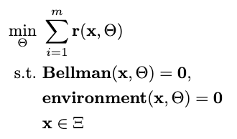

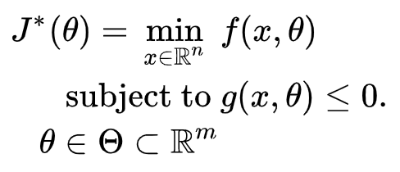

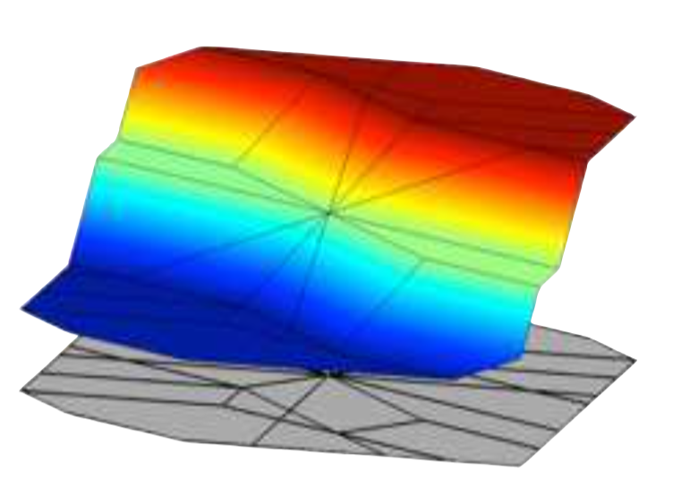
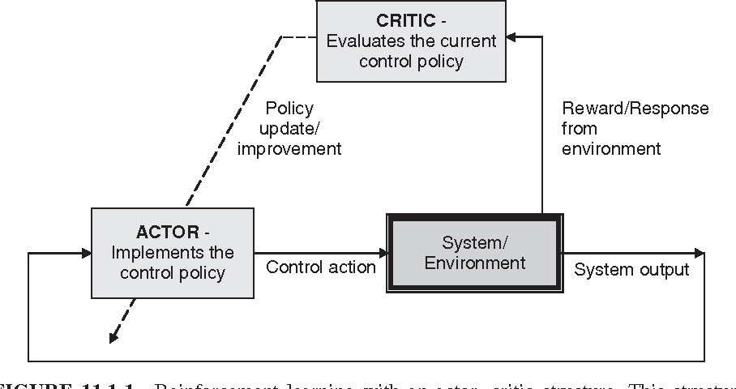

Landscape of Optimization Methods
Online optimization
Parametric programming
Supervised Learning
Reinforcement Learning
“online” solution for given parameter values
computationally demanding in real-time
“offline” optimization obtains a solution map
classical methods lead to exponential complexity!
“offline” optimization
obtains a model (map)
scalable but requires expert optimizer to imitate
“offline” optimization
obtains a policy map
classically can’t handle constraints

Slide 5

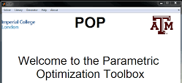




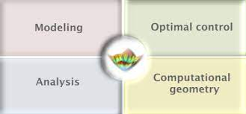

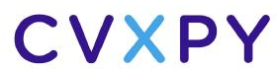

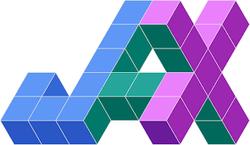



Landscape of Optimization Tools
Online optimization
Parametric programming
Supervised Learning
Reinforcement Learning
Multi-parametric Toolbox (MPT)

Slide 6
Landscape of Optimization Tools
Online optimization
Parametric programming
Supervised Learning
Reinforcement Learning
Multi-parametric Toolbox (MPT)
What comes next? … Differentiable programming (DP): a unifying approach for data-driven parametric optimization with solutions based on automatic differentiation (AD)

Slide 7
Differentiable Programming for Scientific Machine Learning
Differentiable Programming
M. Innes, et al., A Differentiable Programming System to Bridge Machine Learning and Scientific Computing, 2019
Physics-informed Neural Networks
M. Raissi, et al., Physics-informed neural networks: A deep learning framework for solving forward and inverse problems involving nonlinear partial differential equations, 2019
Neural Differential Equations
R. T. Q. Chen, et al., Neural Ordinary Differential Equations, 2019
C. Rackauckas , et al., Universal Differential Equations for Scientific Machine Learning, 2021
Differentiable Optimization
A. Agrawal, et al., Differentiable Convex Optimization Layers, 2019
P. Donti, et al., DC3: A learning method for optimization with hard constraints, 2021
S. Gould, et al., Deep Declarative Networks: A New Hope, 2020
J. Kotary, et al., End-to-End Constrained Optimization Learning: A Survey, 2021
Differentiable Control
B. Amos, et al., Differentiable MPC for End-to-end Planning and Control, 2019
S. East, et al., Infinite-Horizon Differentiable Model Predictive Control, 2020

Slide 8
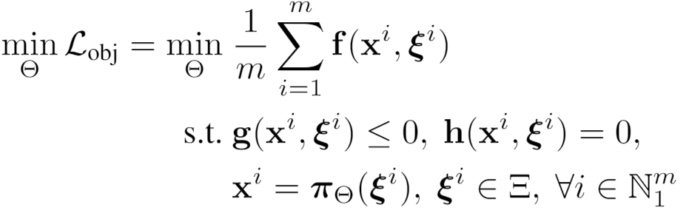
Parametric Optimization via Differentiable Programming
Problem formulation:

Slide 9
Parametric Optimization via Differentiable Programming
Objective function
Problem formulation:
Constraints
Primal optimizers
Scenarios
Solution map
Parameters

Slide 10
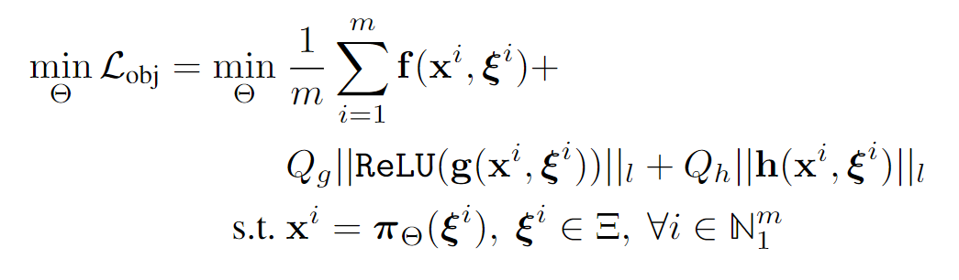
Parametric Optimization via Differentiable Programming
Objective function
Problem formulation:
Constraints
Primal optimizers
Scenarios
Solution map
Parameters
Lagrangian form:
Constraints penalties
Gradient-based optimization based on AD

Slide 11
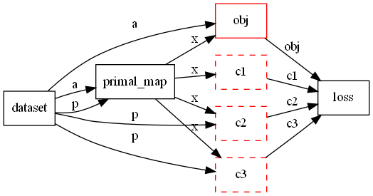
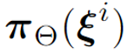

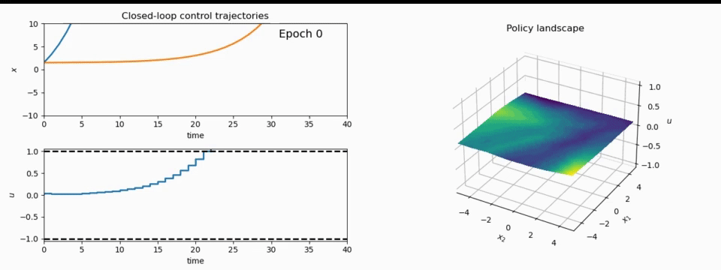
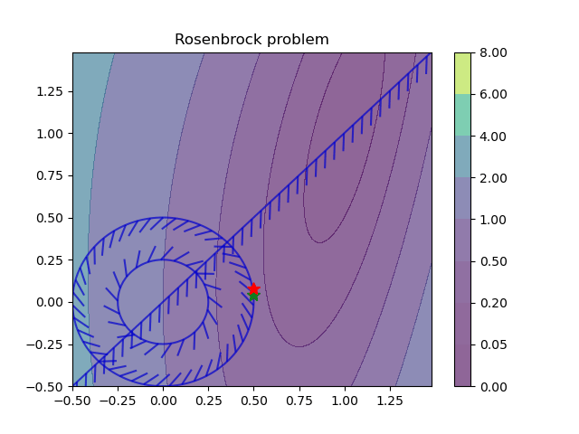
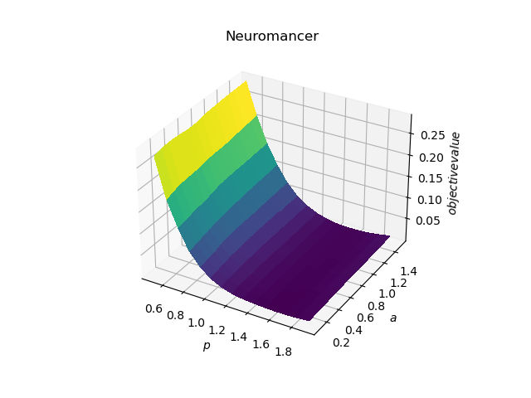
NeuroMANCER: a Scientific Machine Learning Library in PyTorch
import neuromancer as nm
p = nm.constraints.variable(‘p’)
x = nm.constraints.variable(‘x’)
y = nm.constraints.variable('y’)
net = nm.blocks.MLP(insize=2, outsize=2, hsizes=[80]*4) map = nm.maps.Map(net, input_keys=['p’], output_keys=[‘x’,‘y’]) obj = (x ** 2 + y ** 2).minimize(weight=1.0, name='obj’) con_1 = Q_con*(-x - y + p <= 0)
con_2 = Q_con*(x + y – p <= 0)
loss = nm.loss.PenaltyLoss([obj], [con_1, con_2]) problem = nm.problem.Problem([map], loss)
optimizer = torch.optim.AdamW(problem.parameters()) trainer = nm.Trainer(problem,data,optimizer)
best_model = trainer.train()
https://github.com/pnnl/neuromancer

Slide 12
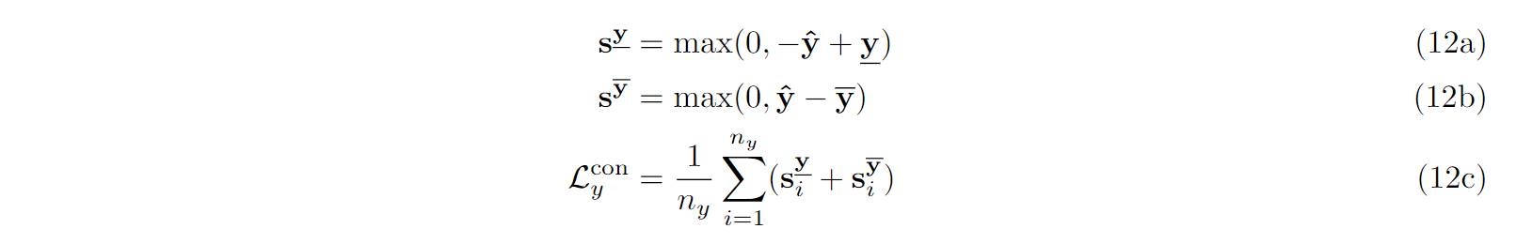
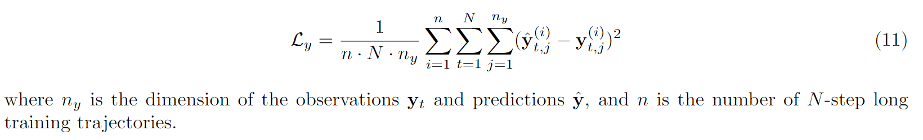
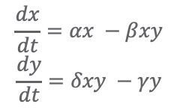
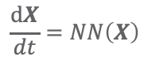
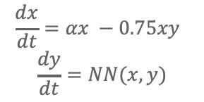
Differentiable Programming for Modeling Dynamical systems
Methods:
Ordinary Differential Equations
Neural Ordinary Differential Equations
Universal Differential Equations
White-box:
Black Box:
Gray-box:
$$\frac{dx}{dt}=αx −βxy$$
$$\frac{dy}{dt}=δxy −γy$$
$$\frac{dx}{dt}=αx −0.75xy$$
$$\frac{dy}{dt}=NN(x,y)$$
$$\frac{dX}{dt}=NN\left(X\right)$$
Dataset: time series of inputs and outputs
PINN Loss:
Code examples:
https://github.com/pnnl/neuromancer/tree/master/examples/system_identification
Ricky T. Q. Chen, et al., Neural Ordinary Differential Equations, arXiv:1806.07366, 2018
Christopher Rackauckas, et al., Universal Differential Equations for Scientific Machine Learning, arXiv:2001.04385, 2019

Slide 13
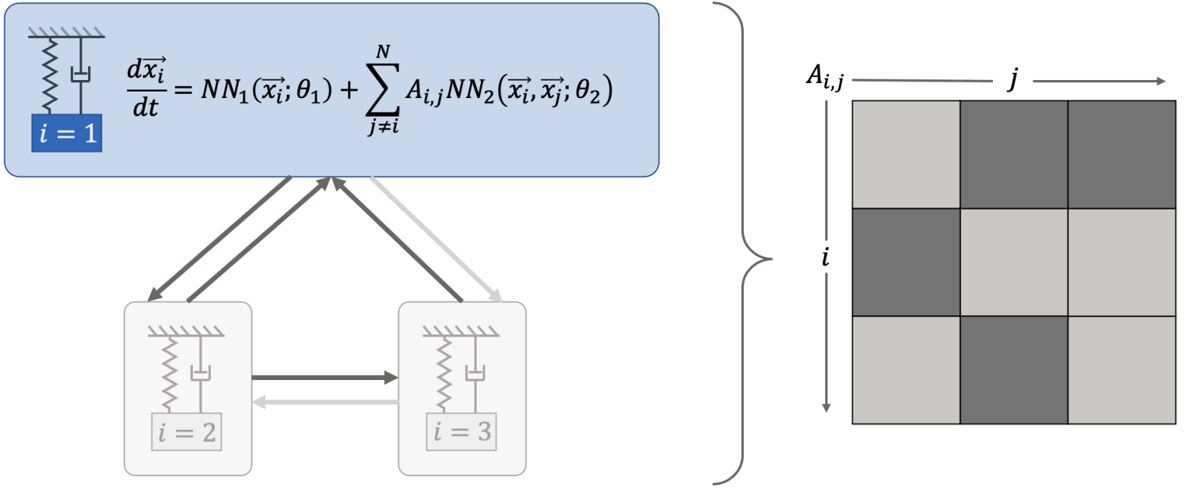
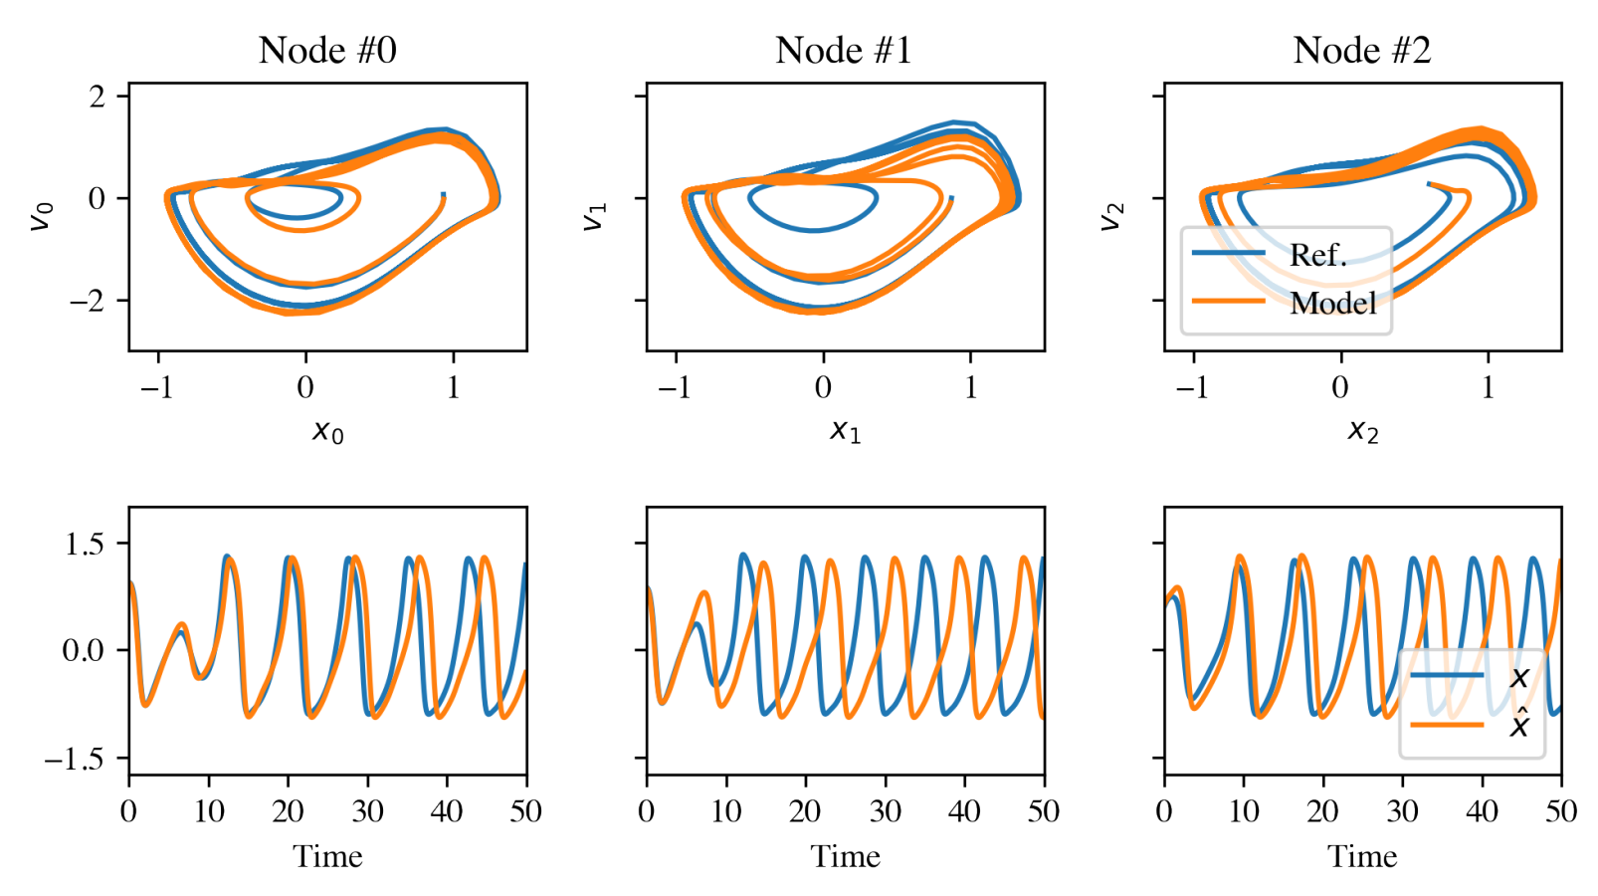
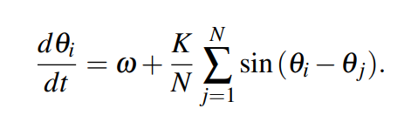
Networked Dynamical Systems via Universal Differential Equations
Network of unknown oscillators
Coupling adjacency
Qualitative out of distribution generalization of learned dynamics on never-seen network topology.
Ground truth Kuramoto system:
James Koch, et al., Structural Inference of Networked Dynamical Systems with Universal Differential Equations, arXiv:2207.04962, 2022

Slide 14
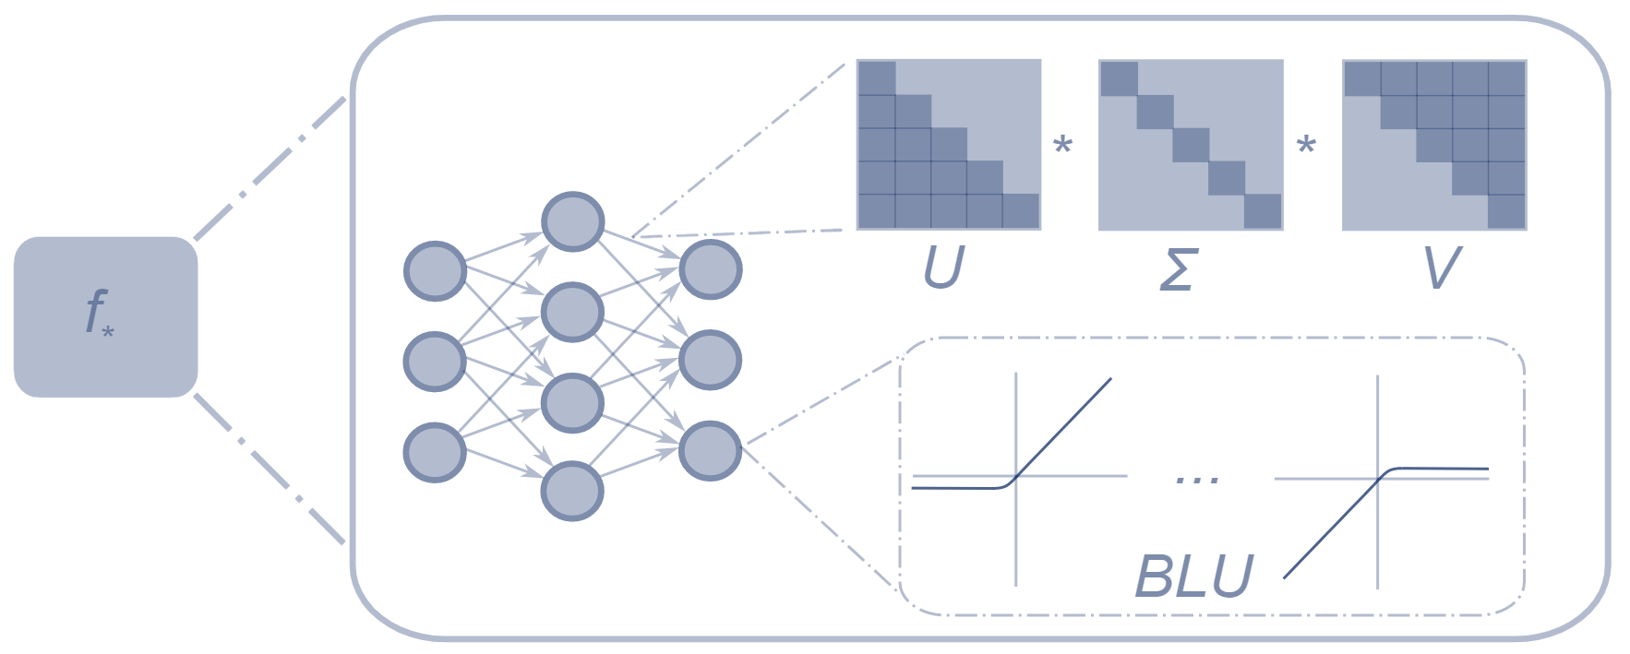
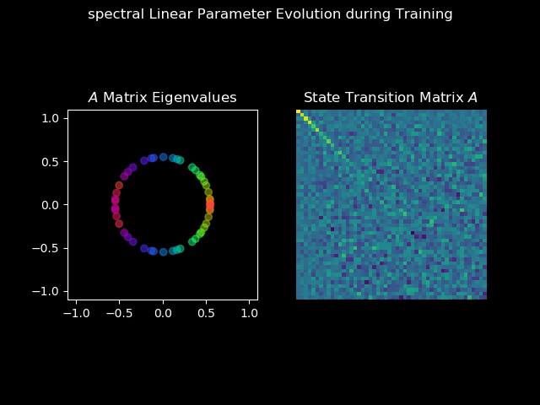
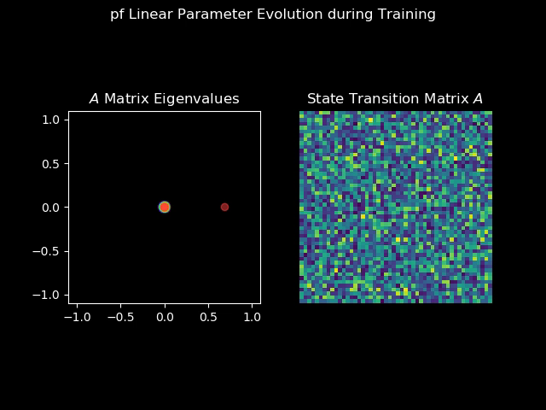
Structured Linear Maps (SLiM)
Factorizations and regularizations of linear maps with predetermined structure
Can be used to enforce sparsity, spectral properties, or other linear algebra properties
Spectral map
Perron-Frobenius map
https://github.com/pnnl/slim

Slide 15
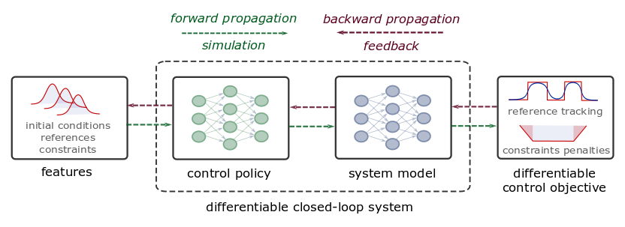
Differentiable Predictive Control (DPC)
From data to optimized explicit predictive control policy
Sample control parameters
Forward pass: simulate closed loop system rollout
Backward pass: propagate errors of the control loss
Jan Drgona, et al., Differentiable Predictive Control: An MPC Alternative for Unknown Nonlinear Systems using Constrained Deep Learning, Journal of Process Control, 2022

Slide 16
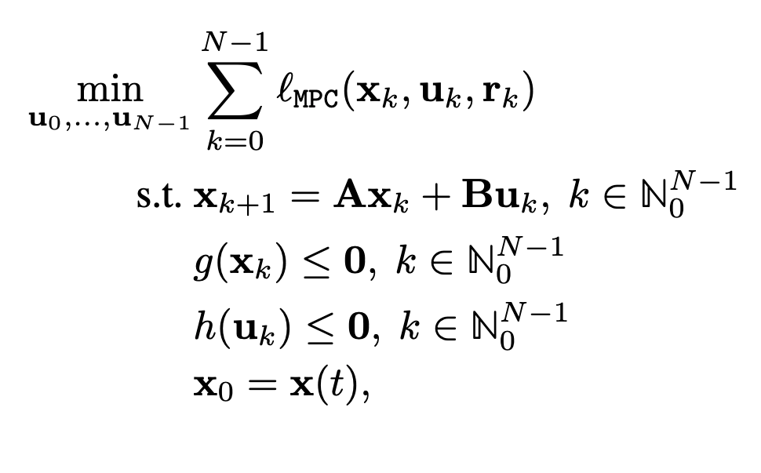
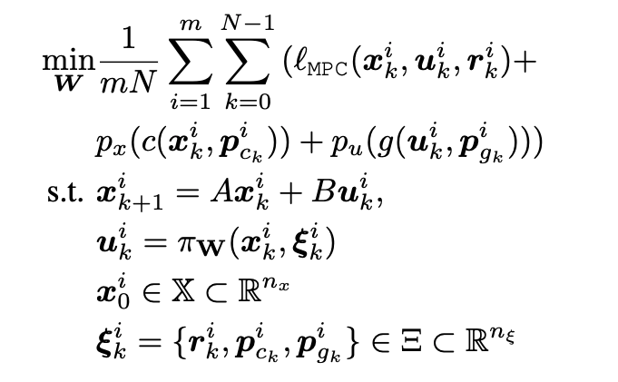
Differentiable Predictive Control (DPC)
From data to optimized explicit predictive control policy
MPC
DPC
Cost:
Model:
Constraints:
Online optimization
Optimize for control actions
Implicit solver-based control policy
Offline optimization
Optimize for control policy parameters
Explicit neural control policy
Jan Drgona, et al., Differentiable Predictive Control: An MPC Alternative for Unknown Nonlinear Systems using Constrained Deep Learning, Journal of Process Control, 2022

Slide 17
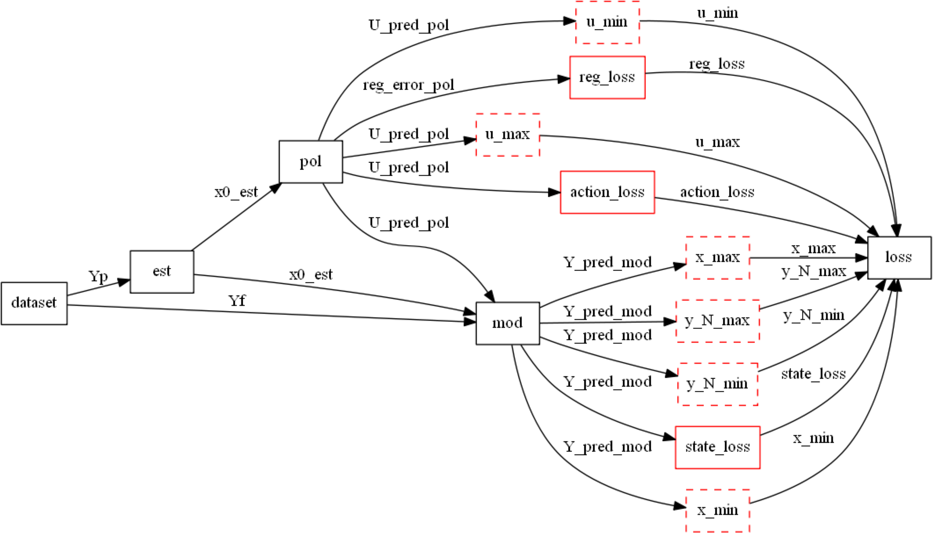
Differentiable Computational Graphs and Model-based Policy Gradients
Constructing differentiable computational graph: implementing parametric MPC problem in NeuroMANCER.
https://github.com/pnnl/neuromancer

Slide 18
Differentiable Computational Graphs and Model-based Policy Gradients
Forward pass: evaluate graph components (policy, model, constraints, objective terms) to compute structured learning loss function.
https://github.com/pnnl/neuromancer

Slide 19
Differentiable Computational Graphs and Model-based Policy Gradients
Forward pass: evaluate graph components (policy, model, constraints, objective terms) to compute structured learning loss function.
https://github.com/pnnl/neuromancer

Slide 20
Differentiable Computational Graphs and Model-based Policy Gradients
Forward pass: evaluate graph components (policy, model, constraints, objective terms) to compute structured learning loss function.
https://github.com/pnnl/neuromancer

Slide 21
Differentiable Computational Graphs and Model-based Policy Gradients
Forward pass: evaluate graph components (policy, model, constraints, objective terms) to compute structured learning loss function.
https://github.com/pnnl/neuromancer

Slide 22
Differentiable Computational Graphs and Model-based Policy Gradients
Forward pass: evaluate graph components (policy, model, constraints, objective terms) to compute structured learning loss function.
https://github.com/pnnl/neuromancer

Slide 23
Differentiable Computational Graphs and Model-based Policy Gradients
Forward pass: evaluate graph components (policy, model, constraints, objective terms) to compute structured learning loss function.
https://github.com/pnnl/neuromancer

Slide 24
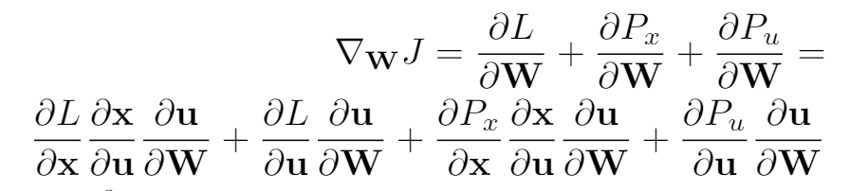
Differentiable Computational Graphs and Model-based Policy Gradients
Backward pass: Differentiate the computational graph to train the policies using automatic differentiation (AD) tools.
https://github.com/pnnl/neuromancer

Slide 25
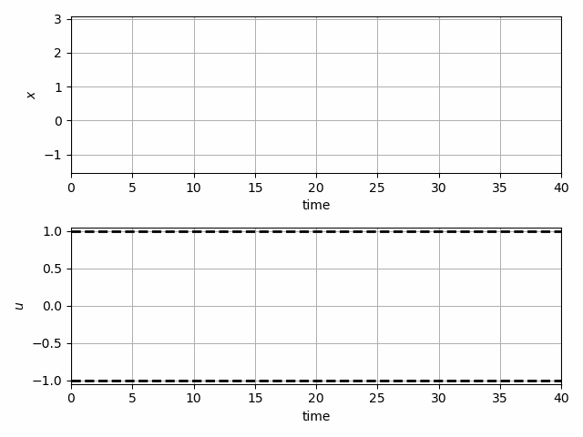
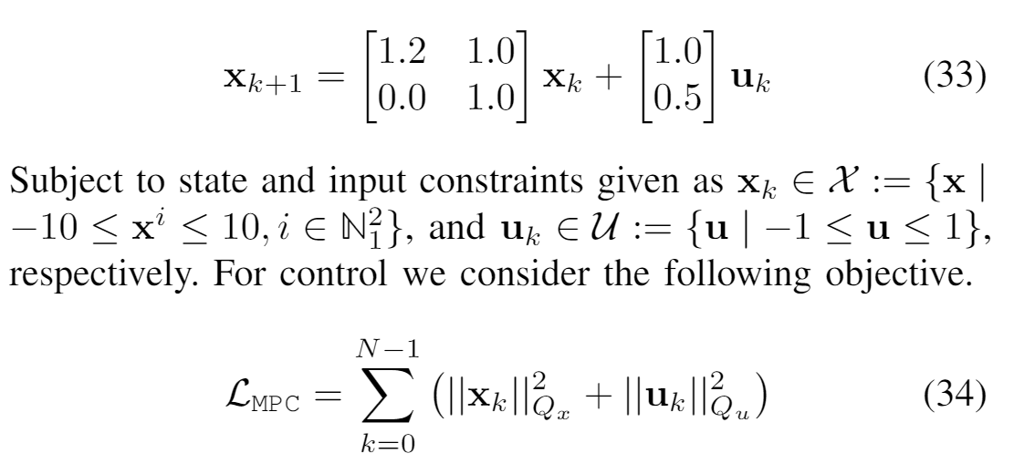
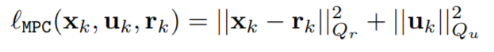
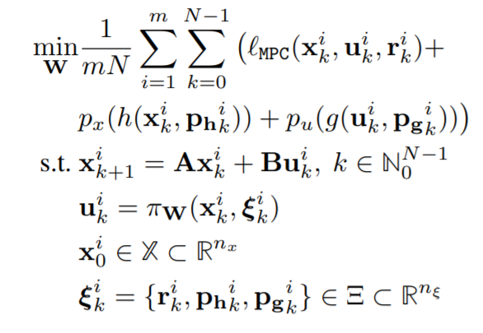
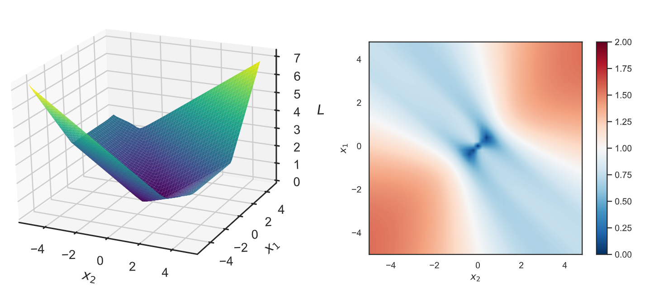
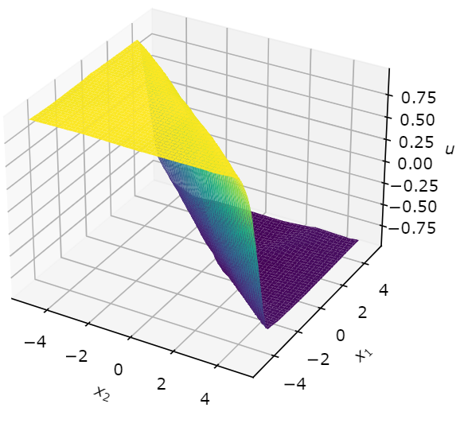
Learning to Stabilize Unstable System
Problem setup:
DPC formulation:
Jan Drgona, Aaron Tuor, Draguna Vrabie, Learning Constrained Adaptive Differentiable Predictive Control Policies With Guarantees, https://arxiv.org/abs/2004.11184

Slide 26
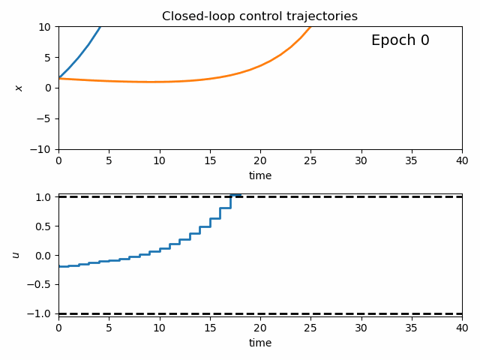
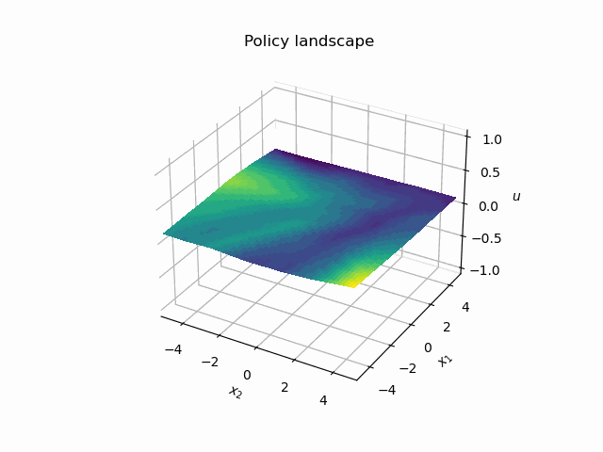
Dynamics of DPC Control Policy Learning
1341 learning parameters, 48.2 seconds offline training time on a CPU with 200 epochs.
Jan Drgona, Aaron Tuor, Draguna Vrabie, Learning Constrained Adaptive Differentiable Predictive Control Policies With Guarantees, https://arxiv.org/abs/2004.11184

Slide 27
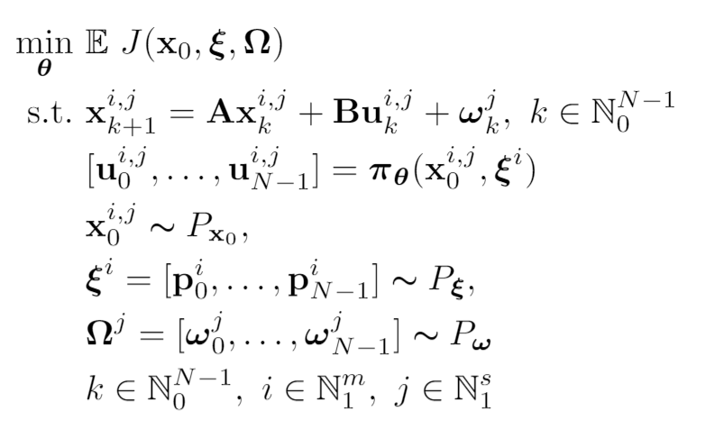
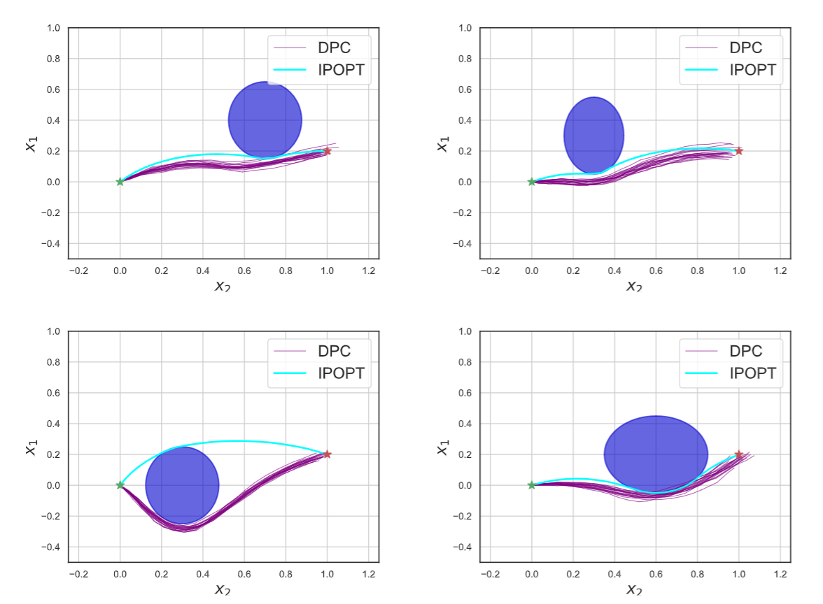
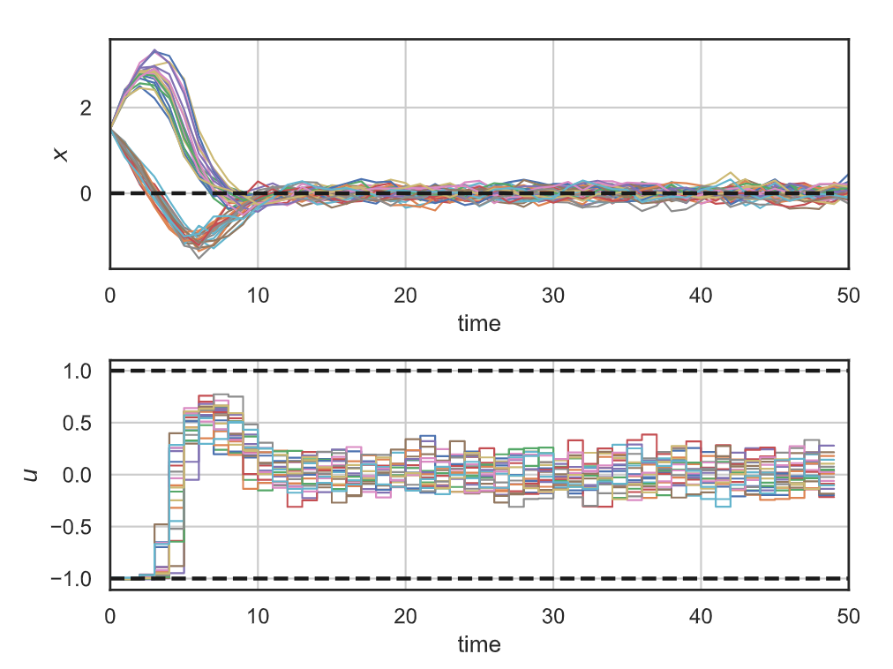
Stochastic Differentiable Predictive Control
Stochastic obstacle avoidance
Stochastic
formulation
Parameters
Uncertainties
Robustness
to state noise
Jan Drgona, Sayak Mukherjee, Aaron Tuor, Mahantesh Halappanavar, Draguna Vrabie, Learning Stochastic Parametric Differentiable Predictive Control Policies, arXiv:2203.01447, to appear at IFAC ROCOND 2022

Slide 28
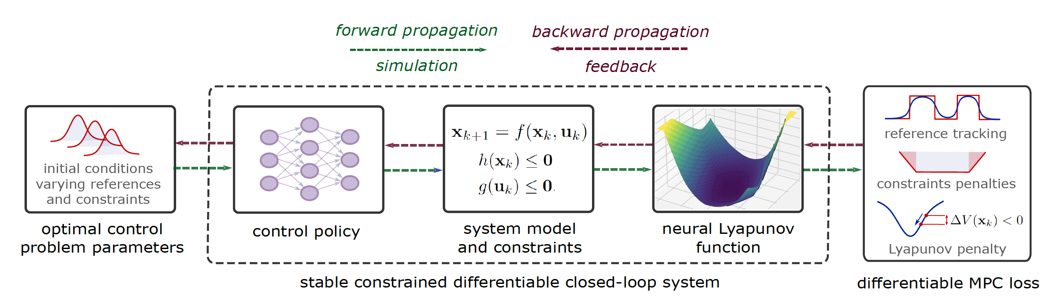
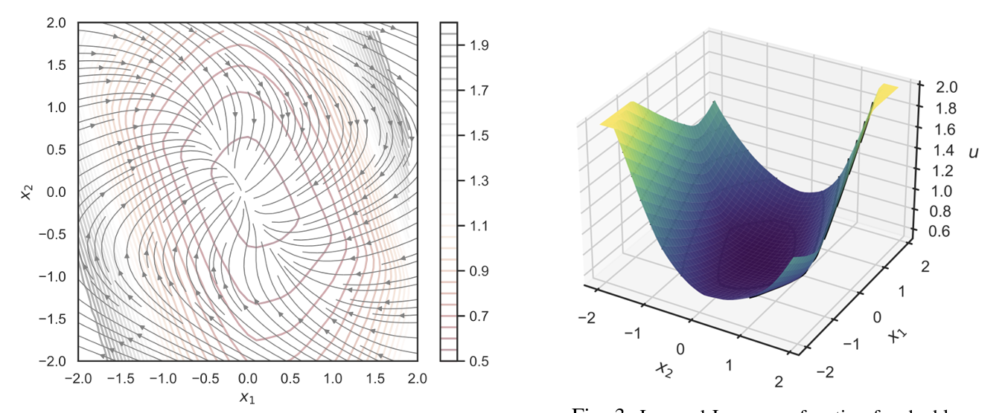
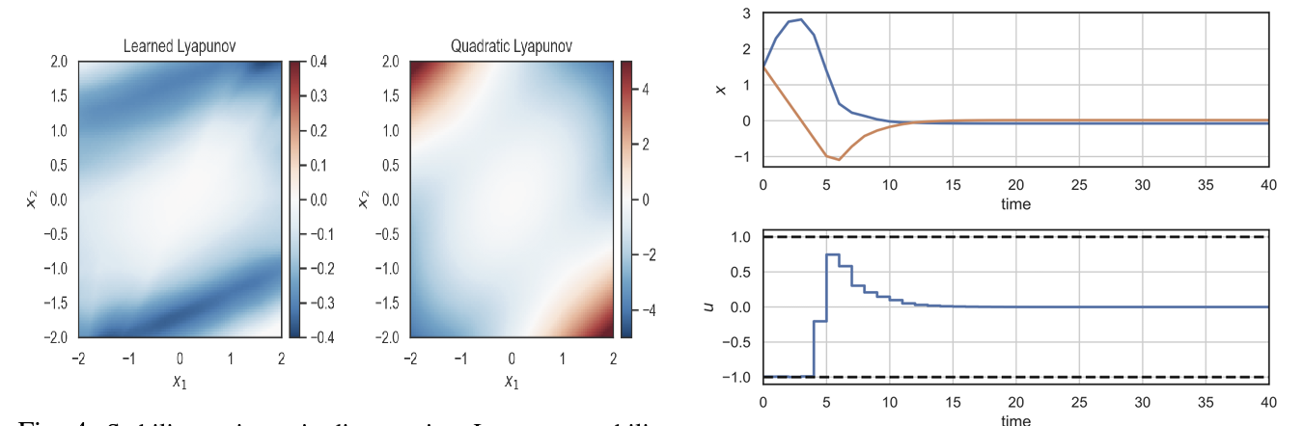
Learning Stable Policies via Neural Lyapunov Differentiable Predictive Control
Sayak Mukherjee, Ján Drgoňa, Aaron Tuor, Mahantesh Halappanavar, Draguna Vrabie, Neural Lyapunov Differentiable Predictive Control, arXiv:2205.10728, 2022

Slide 29
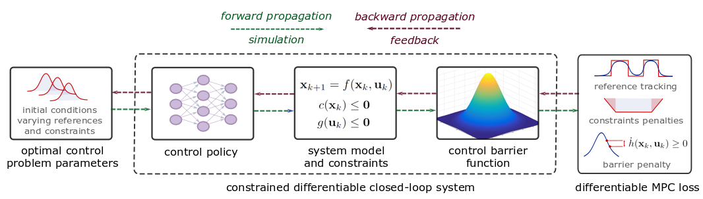
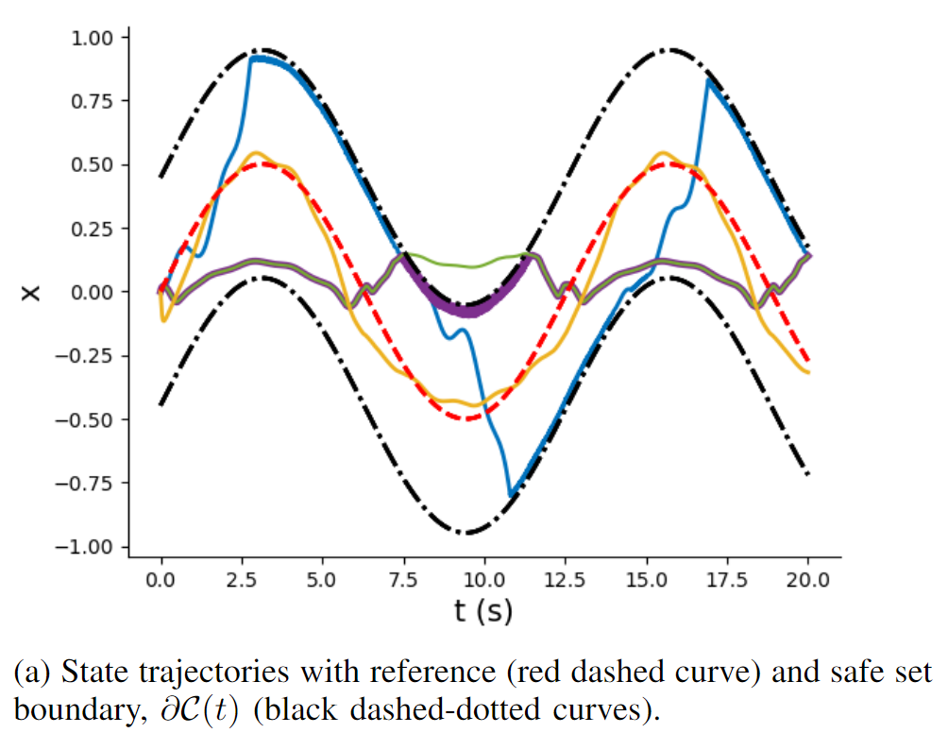


Learning Safe Policies via Differentiable Predictive Control with Control Barrier Functions
Wenceslao Shaw Cortez, et al., Differentiable Predictive Control with Safety Guarantees: A Control Barrier Function Approach, arXiv:2208.02319, 2022

Slide 30



Economic Differentiable Predictive Control of Building Energy System
Architectures
Neural state space dynamics model
MLP control policy architecture
Results
Multi-input multi-output system dynamics
Dynamic economic control objective
Parametric constraints
Jan Drgona, Aaron Tuor, Elliott Skomski, Soumya Vasisht, Draguna Vrabie, Deep Learning Explicit Differentiable Predictive Control Laws for Buildings, IFAC NMPC 2021

Slide 31


Dynamics-Aware Economic Redispatch via Differentiable Predictive Control
Problem: Current redispatch processes do not incorporate system dynamics concerns. Incorporating dynamics in redispatch is too complex and/or time-consuming
Architectures
Koopman dynamics model
CNN control policy
Solution: Machine-learning based dynamics-aware redispatch. Learn system dynamics for faster assessment.
Results
5 orders of magnitude speed-up
Near optimal performance
Ethan King, Ján Drgoňa, Aaron Tuor, Shrirang Abhyankar, Craig Bakker, Arnab Bhattacharya, Draguna Vrabie, Koopman-based Differentiable Predictive Control for the Dynamics-Aware Economic Dispatch Problem, 2022 American Control Conference

Slide 32
Embedded Implementation of DPC
Flexy-Air system sketch with Raspberry-Pi controller
Performance comparison: reference (red dashed), position controlled with PI controller (green), explicit model predictive control (purple), constrained differentiable predictive control (blue) and constraints (black-dashed). Bottom figures show the fan speed controls
Jan Drgona, Karol Kis, Aaron Tuor, Draguna Vrabie, Martin Klauco, Differentiable Predictive Control: An MPC Alternative for Unknown Nonlinear Systems using Constrained Deep Learning; Journal of Process Control, 2022

Slide 33
Differentiable Predictive Control (DPC) Recap
From data to explicit constrained control policy via differentiable optimization
Pros:
Cons:
Theoretical connection with MPC
Structured offline learning
Parametric solution of the MPC problem
Handling state and input constraints
Handling of arbitrary differentiable models
Can’t handle integer variables
Sampling-based

Slide 34

NeuroMANCER
Open-source scientific machine learning (SciML) toolbox in PyTorch for integrating deep learning, constrained optimization, and physics-based modeling
Differentiable constrained optimization
Parametric nonlinear programs (pNLP)
Constrained machine learning
Classical deep learning (RNN, MLP, ResNet)
Graph neural nets (GNNs)
Physics-informed modeling of dynamic systems
Neural state space models (NSSM)
Neural ordinary differential equations (NODE)
Constrained control of dynamic systems
Differentiable predictive control (DPC)
https://github.com/pnnl/neuromancer

Slide 35














Acknowledgements
Aaron Tuor
James Koch
Zhao Chen
Stefan Dernbach
Christian M. Legaard
Ethan King
Sayak Mukherjee
Wenceslao Shaw Cortez
Soumya Vasisht
Shrirang Abhyankar
Mahantesh Halappanavar
Draguna Vrabie

Slide 36

Get in touch
Email: jan.drgona@pnnl.gov
LinkedIn: https://www.linkedin.com/in/drgona/
Repository: https://github.com/pnnl/neuromancer
Youtube: https://www.youtube.com/@neuromancer_SciML

